Slide 1
"Pathways to Funding for Aging-Focused Research in Pulmonary and Critical Care Medicine" NIA Funding Opportunities
Susan Zieman, M.D., Ph.D., Marcel Salive, M.D., M.P.H.
Program Officers, Geriatrics Branch
Division of Geriatrics and Clinical Gerontology, NIA, NIH
ATS 2021 Aging Interest Group Annual Virtual Meeting
Cyberspace
Jun 23, 2021

Slide 2
Topics I’ll Touch On:
Overview of NIA and what we fund
Opportunities for Early Career Investigators
GEMSSTAR Award
Beeson Award
Steven I Katz ECI
Clin-STAR
Other Resources

Slide 3
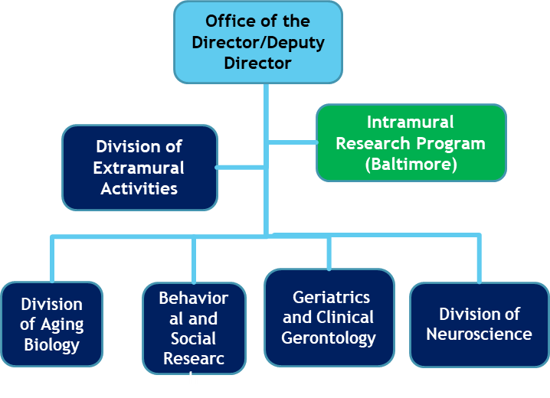
Overview of the NIH/NIA: Who Are We?
National Institutes of Health
National Institute on Aging
NIH is made up of 27 institutes and centers (ICs)
Most have Intramural and Extramural Programs
ICs award >80% of the NIH budget each year
Minimal budget to support staff
Each IC has a budget and a director, and typically their own review for early career/training awards and RFAs (like GEMSSTAR)
The Center for Scientific Research (CSR) oversees triage and review of most applications
3rd largest IC at NIH
Primary funder of Alzheimer’s Disease and Related Dementias
Mission and Strategic Direction
4 Divisions

Slide 4
NIA Mission
NIA’s mission is to:
Support and conduct genetic, biological, clinical, behavioral, social, and economic research on aging.
Foster the development of research and clinician scientists in aging.
Provide research resources.
Disseminate information about aging and advances in research to the public, health care professionals, and the scientific community, among a variety of audiences.
https://www.nia.nih.gov/about/mission

Slide 5
Which IC is Right for My Research?
NIA
NIA Focus
Smaller, very personal, responsive
But with AD/ADRD funds, we are now the 3rd largest (by budget) IC
80% to Alzheimer's
Focus on early career investigators
Early Career Investigators- w/i 10 yrs terminal degree
New Investigators - 1st R01
GEMSSTAR and Beeson
Tough K payline – but will understand specific aging focus
Inform science of aging
WHY older adults are more vulnerable?
Elucidate alterations in disease presentation, management, prevention in older adults
Geriatric conditions, syndromes, complexities
Focus on outcomes of QOL, function, cognition and independence. Patient-oriented research.
Talk to Project Officers at BOTH Institutions BEFORE applying!!
WE BOTH WANT YOU TO SUCCEED!!!!

Slide 6
NIA Training, Fellowship, and Career Development Awards
https://nexus.od.nih.gov/all/2011/10/07/trends-in-nih-training-and-career-development-awards/
https://www.nia.nih.gov/research/training
Transition to Aging Research for
Predoctoral Students (F99/K00)
Short-term Institutional Training Grant (T35)
Stimulating Access to Research
in Residency (StARR R38 / K38)
Senior Fellow Award (F33)
GEMSSTAR (R03)
Paul B. Beeson Career Development Award (K76)
Academic Career Development Award (K07)

Slide 7
Grants for Early Medical and Surgical Specialists’ Transition to Aging Research (GEMSSTAR) – Nuts and Bolts
Why was GEMSSTAR created?
To attract and foster medical/surgical/dental specialist clinician researchers to improve care of older adults within their specialty
What is it?
NIA-sponsored annual award (approx.15 awards/y)
RFA-AG-022-027 to be released this summer, (RFA-AG-21-023 - last year)
RECEIPT DATE: late Oct/early Nov 2021, Review- approx. Feb 2022, Funding start – July/Aug 2022
Who is it for?
Clinician Researchers, MD or equivalent, Early Career (faculty position at start of funding), no prior K* or R01 type award
Goal- to obtain preliminary data in aging research, mentor in aging/geriatrics, career development skills, join community of specialist researchers, flexibility in effort – to launch a career in aging research within specialty (K, R01, etc)
Other Info:
Reviewed by NIA Special Emphasis Panel – have aging expertise by broad array of backgrounds – PDP is NOT reviewed by NIA and will not impact score
Letter of Intent (due 1 month before deadline) – optional but helpful to obtain optimal expertise on review panel
NIA PO’s can offer feedback – please prepare ahead, POs have no input on peer review/score
ALL COMMUNICATION via GEMSSTAR EMAIL – niagemsstar@mail.nih.gov GEMSSTAR FAQ Website
FOLLOW RFA INSTRUCTIONS CAREFULLY!!!!!! – THIS IS A LONG PROCESS- PATIENCE IS ESSENTIAL!!
NIA funded R03
$100k DC/y x 2 y
Individualized Professional Development Plan (PDP) 2y,
Applicant-identified funding source
https://www.nia.nih.gov/research/dgcg/grants-early-medical-surgical-specialists-transition-aging-research-gemsstar

Slide 8
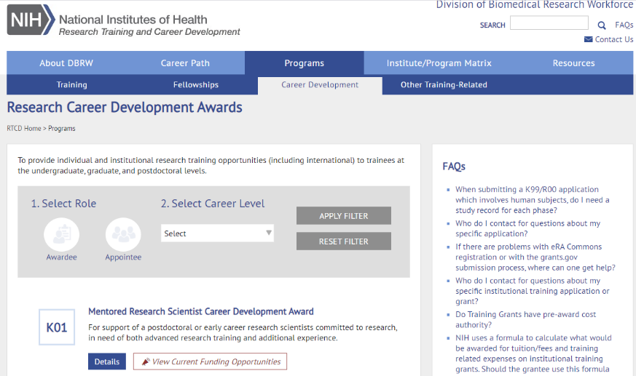
Career development opportunities Where do I start?? The Kiosk

Slide 9
Career Development Awards https://researchtraining.nih.gov/
Mentored Career Development Awards
Parent K01 (Research Scientist), K08 (Clinical Scientist), K23 (Patient-Oriented) - 3 cycles/yr- $100k/yr
Paul B. Beeson Emerging Leaders Career Development Award in Aging (K76) “K deluxe” – set-aside –7-10 awards – 1 cycle/yr- RFA approx.?June 2020, Due ?2/2021, funding 7/21
RFA-AG-21-020 Clinical Trial Not Allowed Due 10/22/21, Funding 7/2022
RFA-AG-21-021 Clinical Trial Allowed Due 10/22/21, Funding 7/2022
$225k/yr for 3-5yr (direct costs)
Future leaders in aging research
Leadership experience, prior grant requirement
Health-related research or clinical doctoral degree, including, but not limited to PhD, MD, DO, DDS, DMD, OD, DC, PharmD, DN and DVM. Early Stage Invest. status
May have K but must justify why need more training
Annual Conference for former and current Beeson Scholars
https://www.afar.org/research/funding/beeson/
https://www.johnahartford.org/dissemination-center/view/apply-for-the-paul-b.-beeson-emerging-leaders-career-development-award-in-a
K99/R00 – two phase accelerator award, 2yrs/3yrs

Slide 10
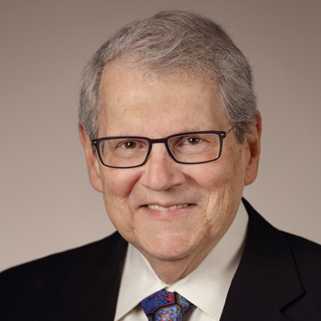
Stephen I. Katz Early Stage Investigator Research Project Grant
A special R01 award for ESI’s who are pursuing a new research direction for which there is no preliminary data
Supported by most NIH IC’s (including NIA)
No budget limit, 5 years, non-standard receipt dates (3 times/yr)
Reviewed in standing CSR study sections
Stephen Katz, NIAMS Director (1998-2018)
https://grants.nih.gov/funding/katz-esi-r01.htm

Slide 11
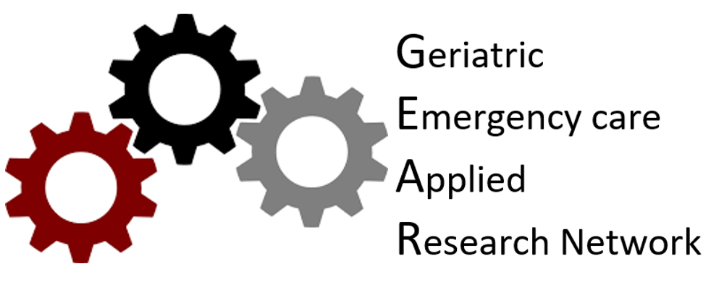
Additional Opportunities for
Early Career Investigators: GEARS 1
Mission: Build a research infrastructure for interdisciplinary aging studies focused on geriatric care in the ED.
1. Establish research priorities, standard measures & approaches for geriatric emergency care syndromes.
2. Build a validated metrics data bank for geriatric emergency care research.
3. Facilitate future multicenter proposals and applications for pragmatic trials, dissemination and implementation studies, and other interdisciplinary projects to advance best practices in geriatric emergency care.
R21: Scoping reviews and consensus research priorities in Cognitive Impairment (delirium), Care Transitions, Medication Safety, Falls, and Elder Abuse. (2018-2020)
R33: Create a multicenter data bank that is tested and validated with prospective data from GEDC sites.
Foster and support interdisciplinary, multicenter pilot studies using GEAR infrastructure (RFA issued Fall 2021) for 3, 1-year pilot studies (total funding $85K). (2021-2023)
Contact: Drs. Ula Hwang and Manish Shah
ula.hwang@yale.edu, mnshah@medicine.wisc.edu

Slide 12
Clin-STAR – A Network with Resources for Specialists in Aging Research!
More Resources for Investigators focusing on Aging/Geriatrics aspects within Specialties:
Introducing Clinician Scientists Transdisciplinary Aging Research – Clin-STAR – a Virtual Wonderland of Opportunities!! Funded by NIA to American Federation of Aging Research (AFAR)
RESEARCH COLLABORATION
Indep Funded Invest/Leaders in Aging/Specialties
NETWORKING
VIRTUAL PLATFORM
200+ Beeson Scholars
Aging Research Leaders (MD, PhD, SW, RN, Etc)
MENTORING & CAREER DVMT
T Franklin Williams & Jahnigen Scholars (specialtists) MD/DO
RESEARCH RESOURCES
147 GEMSSTAR
32 specialties
MD/DO/DDS
EDUCATIONAL ADVANCES
Actively Engaged in Research
MD, PhD, SW, Therapists, Rehab, Nurses, Psychologists
MSTAR, Butler-Williams, F31/32
1U24 AG065204-01

Slide 13
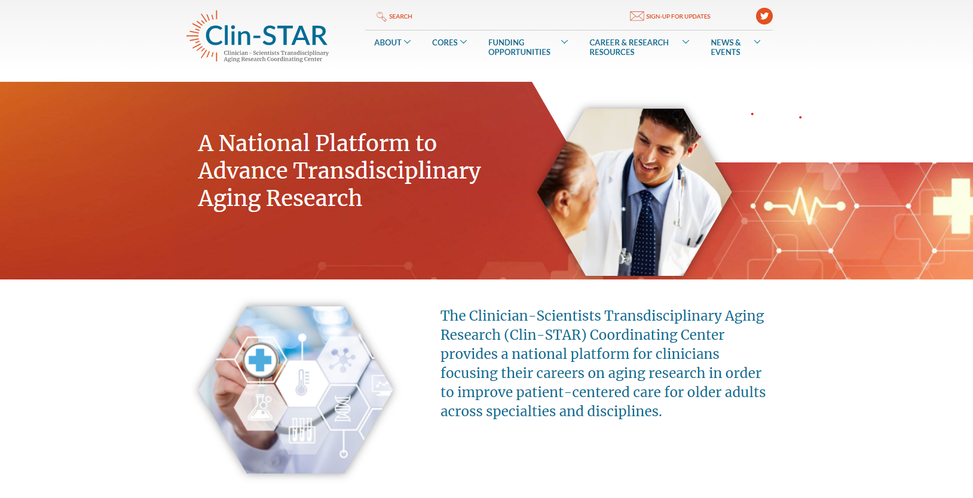
Clin-STAR Coordinating Center
Website: Clin-STAR.org
Twitter: @ClinSTARCC

Slide 14
Synergizing Career Development Toward Improved Care of Older Adults across Specialties and Disciplines
What is it?
Virtual community of clinically focused researchers to facility collaboration, networking, research opportunities, career development, mentoring and consolidate resources. Funded by NIA by 5 year U24. Administrative Supplement- to collaborate with AGS (Rising Star Program) and help to integrate specialty community and AGS Annual Meeting.
List-serv informs of opportunities, Database facilitates interactions/searching/ resource sharing/remote mentoring, etc.
Who is for?
Clinician researcher focused on bridging specialties and geriatrics – any discipline, any training/career level. NIA-funded free resource.
How does it facilitate transdisciplinary aging research?
“One Stop Shop” for webinars, funding opportunities, research and career resources. We welcome posting pertinent info from your specialty.
Database of aging specialty researchers – ability to connect with those in various specialties on a specific problem, finding like souls, how to set up a geriatric specialty aging practice, collaborating and extending specialized techniques/tools, multisite clinical trials, specific interest groups, medical/surgical projects, finding a mentor.
Pilot funding, Office hours for mentoring, Mini-Sabbaticals, Distinguished Professor Program, Webinars on various research topics, upcoming series in JAGS, opportunities to collaborate with leaders in field or access geriatric/aging resources., annual meeting.
What’s in it for me (my specialty community)?
Please encourage those in your field interested in aging/geriatric research to sign on to the ListServ to keep on top of upcoming opportunities (webinars, funding, mentoring, career development, etc)
Please encourage those in your field interested in aging/geriatric research to sign into the database (5-7 min) which will allow you to interact/search/collaborate, etc with those in the community. You are the GAS which fuels the ClinSTAR initiative.

Slide 15
https://www.nih.gov/ending-structural-racism/nih-extramural-applicants-awardees
Notes:
Concrete actions to achieve this goal include:
Aggressively and immediately implement approaches to address the funding gap for Black/African American researchers and enhance portfolio diversity to appeal to scientists across the research spectrum, including researchers from underrepresented groups.
Expand existing extramural grant funding data to include funding support by race and ethnicity.
Develop a sustainable process to gather systematically the demographics of our extramural scientific staff, including program and review staff and make the information publicly available.
Review and evaluate existing NIH diversity programs in:
Diversity, training, career development, and capacity building
Peer review
Equity of interactions between NIH staff and the community
Limitations of NIH funding mechanisms and policies, pre-application processes, and application submission forms and systems
Review diversity programs at other organizations, for example, the American Association for the Advancement of Science (AAAS) SEA Change and the National Science Foundation ADVANCE, to gather best practices.
Seek input from extramural stakeholders through listening sessions and an online Request for Information to inform NIH strategies to enhance diversity and inclusion in the biomedical research workforce and develop a more robust portfolio of research to better understand and address inequities in our existing system.

Slide 16
Additional NIA Resources
People and Resources
Funding Opportunities
Butler-Williams NIA Summer Institute – week long aging ‘course’ at NIA – 50 scholars, each summer
Established NIA-Funded Centers
Research Centers Collaborative Network (RCCN)
OAIC, Nathan Shock, Roybal, RCMAR, ADRC
NIA/NIH Measures and Instruments
PROMIS, NIA Toolbox, Clin-STAR
NIA/NIH Cohorts
Establish NIA-Funded Networks
AGING, Deprescribing, Emergency Medicine, Delirium
Clinician-Scientist Transdisciplinary Aging Research Coordinating Center (Clin-STAR)
IMPACT Collaboratory
Your Program Officer!
Council Approved Concepts for Funding Published after each Council Meeting (see blog next few weeks) https://www.nia.nih.gov/research/initiatives/approved-concepts
Loan Repayment Program – up to $50k/yr
Pilot Studies – from Networks and Centers (RCCN)
Clin-STAR Pilot Grants
IMPACT Collaboratory
AGING Initiative- Multiple Chronic Conditions Scholars, Webinars, Pilots grants
Pepper Centers – Older Adult Independence Centers
GEMSSTAR, AD/ADRD R03, Beeson K76 – joins you to a community of scientists
NIA Blog www.nia.nih.gov/research/blog

Slide 17
NIH Loan Repayment Program
up to $50k/yr
Clinical Research, other topics
Check other features and apply online!
https://www.lrp.nih.gov/

Slide 19
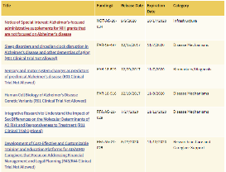
New AD/ADRD Funding Opportunities
From the NIA Blog (www.nia.nih.gov/research/blog)
AD/ADRD Searchable Funding Opportunities
https://www.nia.nih.gov/research/grants-funding/announcements
Small Research Grant Program for the Next Generation of Researchers in AD/ADRD Research (R03)
Systems Biology
Basic Science
Archiving and Leveraging Existing Data Sets for Analyses

Slide 20
Interim NIA FY21 Paylines
ADRD = research on Alzheimer’s disease and Alzheimer’s-related dementias
https://www.nia.nih.gov/research/grants-funding/nia-interim-funding-line-policy-fy-2021

Slide 21
Interim NIA FY21 Paylines (2)
https://www.nia.nih.gov/research/grants-funding/nia-interim-funding-line-policy-fy-2021

Slide 22
Thank you and please remember…. We are here for you!!!
Send your questions and Specific Aims to us or the most relevant PO and we’ll give you feedback.
Susan.Zieman@nih.gov
Marcel.Salive@nih.gov
https://www.nia.nih.gov/research/dgcg/about-gcg-staff-listings
www.nia.nih.gov/research/blog

Slide 23
NIH Releases Final Policy for
Data Management and Sharing
This policy affirms NIH’s continued commitment to share and make broadly available the results of publicly funded biomedical research.
Applies to all research funded or conducted by NIH that results in the generation of scientific data.
Has 2 key requirements, including:
Submission of a data management and sharing plan
Compliance with the approved plan
Available for review: https://grants.nih.gov/grants/guide/notice-files/NOT-OD-21-013.html

Slide 24
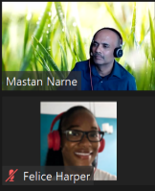
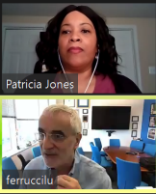
The Butler-Williams Scholars Program
For junior faculty and researchers new to the field of aging
Dates: August 24—26th, 2021 (sorry, deadline passed)
Location: To be held virtually
Eligibility: Doctoral degree - Ph.D., M.D., etc.
For more details and to apply for a future session, please visit:
https://www.nia.nih.gov/research/osp/butler-williams-scholars-program
24

