Slide 1
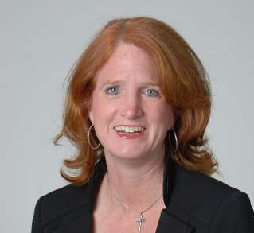
Please join us for the 3rd Annual Meeting of the Neonatal and Developing Lung Interest Group, sponsored by the ATS Respiratory Cell and Molecular Biology and the Pediatric Assemblies.
Co-chaired by Henry Rozycki (hrozycki@mcvh-vcu.edu) and Larry Nogee (lnogee@jhmi.edu)
http://www.thoracic.org/members/assemblies/interest-groups/neonatal-and-developing-lung.php
The ATS Neonatal and Developing Lung Interest Group (NDLIG)
2017 INVITED SPEAKER: Stephanie Davis, MD
Indiana University
Uncovering the Face of Primary Ciliary Dyskinesia in the NICU and Beyond
We will also be honoring the four best NDL abstracts (there is no monetary prize- it’s just for the glory)
Reception and Talk [talk starts at 6pm]
Tuesday May 23rd 5 to 7pm
Location: Renaissance Washington, DC Downtown Hotel
Congressional Hall A&B (Ballroom Level)

