Slide 1
Central Sleep Apnea
Problem Based Learning Module
Vidya Krishnan, and Sutapa Mukherjee
for the Sleep Education for Pulmonary Fellows and Practitioners, SRN ATS Committee
2015

Slide 2
Case – Section I
A 75 year old obese male with chronic systolic heart failure, recalcitrant hypertension, and end-stage renal disease presented to the emergency department of your hospital with sudden onset of shortness of breath and palpitations for the last 2 hours.
Prior to this episode, the patient reports no chest pain, palpitations or dyspnea at rest. He does report dyspnea when walking up 2 flights of stairs. He has been compliant with his medications and his cardiologist reported NYHA 2 heart failure at his last visit 2 months prior. He has developed lower extremity edema over the last 24 hours.

Slide 3
Case – Section II
PMH: chronic systolic heart failure, hypertension, ESRD, chronic lower back pain
PSH: arteriovenous graft of left upper forearm
Medications: metoprolol, lisinopril, furosemide, spironolactone, oxycodone
Allergies: none
Social history: no smoking, alcohol, or illicit drug use history
Family history: both parents with HTN

Slide 4
Questions – Section I
I.A) In general, what risks for sleep disorders are in the presentation of this patient?
I. B) Specifically what are known risk factors for Central Sleep Apnea?
Notes:
I.A. What sleep disorders are this patient at risk for?
- obstructive sleep apnea (older, male, obese, HTN)
- central sleep apnea (systolic heart failure, ESRD)
- obesity hypoventilation
I.B. What are known risk factors for Central Sleep Apnea?
age - >65 years old
sex – men>women – higher apneic threshold in men
heart failure
stroke – especially in first 3 months after stroke
opioid use
acromegaly
renal failure

Slide 5
Case – Section II
He had an irregularly irregular heart rhythm with a II/VI holosystolic murmur at the apex, and heart rate of ~120 beats per minute. Blood pressure was maintained around 130/70 mm Hg (close to his baseline). Lung exam revealed crackles at the bases of the posterior lung fields bilaterally. His oropharynx exam showed a Modified Mallampati of I, with normal tongue and jaw.
The 12-lead electrocardiogram is consistent with atrial fibrillation with a rapid ventricular rate. Echocardiogram from 4 months prior revealed an enlarged left atrium, left ventricular hypertrophy and left ventricular ejection fraction of 35%. His body mass index (BMI) is 34.

Slide 6
Questions – Section II
II. A. What is central sleep apnea?
II. B. Would your assessment for central sleep apnea risk alter with the given information?
II. C. What are the syndromic presentations of central sleep apnea? What type of central sleep apnea might you expect to see on a sleep study in this patient at this time?
Notes:
II. A. What is a central sleep apnea?
Cessation of airflow for at least 10 seconds, without respiratory effort during the event.
II. B. How does your assessment for central sleep apnea risk alter with the given information?
oxycodone can increase risk of central sleep apnea
new onset atrial fibrillation and increased left atrial size can increase the risk of CSA in SHF patient
oropharyngeal exam does not support increased risk of OSA
II. C. What type of central sleep apnea might you expect to see on a sleep study?
What are the types of central sleep apnea?
Primary central sleep apnea
Secondary central sleep apnea
Cheyne Stokes Respiration
Secondary to a medical condition – CNS diseases, neuromuscular disease, severe abnormalities in pulmonary mechanics (such as kyphoscoliosis)
Secondary to a drug or substance
High altitude periodic breathing

Slide 7
Case – Section III
He was admitted for management of atrial fibrillation with rapid ventricular rate. He was given one dose of metoprolol IV and his usual home dose of metoprolol was increased from 25mg twice a day to 75mg twice a day. His usual dose of oxycodone for chronic back pain was continued during his hospital stay.
His heart rate was controlled to ~80bpm, and the patient spontaneously converted to normal sinus rhythm. However, pulmonary exam and CXR were still consistent with pulmonary edema. SpO2 is 85% on room air and 92% on 4Lpm O2 by nasal cannula. The ABG on 4Lpm O2 Is 7.38/28/60

Slide 8
Questions – Section III
III. A. How can pulmonary edema and hypoxemia affect the patterning of breathing during sleep?
III. B. How does the respiratory alkalosis affect sleep (and wake) disordered breathing?
Notes:
IIIA. How can the residual pulmonary edema and hypoxemia affect the sleep disordered breathing?
Pulmonary edema can increase work of breathing and contribute to hypoventilation. Alternatively, the hypoxia and stretch receptor activation can result in hyperventilation. In the case of this patient, acute respiratory alkalosis is consistent with hyperventilation.
Acute cardiogenic pulmonary edema can result in increased left atrial size/stretch, and this finding is associated with Cheyne-Stokes respiration in heart failure.
Pulmonary edema and hypoxemia can also worsen the intermittent hypoxia associated with sleep disordered breathing.
III. B. How can the respiratory alkalosis affect risk of sleep disordered breathing?
Respiratory alkalosis during wake can trigger Cheyne Stokes respiration in this patient. The low PaCO2 can be below the apnea threshold at sleep onset, resulting in an apnea. If the CO2 sensitivity is high, the ventilator response to the CO2 derangements can result in the periodicity of breathing seen in Cheyne Stokes respiration.

Slide 9
Case – Section IIII
Overnight, the ICU nurses noted an abnormal breathing pattern, and called you into the room to observe these witnessed pauses in breathing. The patient had a period of tachypnea and deep breaths, followed by slower and shallower breaths, followed by a period of complete cessation of breathing for approximately 30 seconds. There was no apparent respiratory effort during these witnessed pauses in breathing. The O2 saturations were oscillating from 92-94% to 85-87% while he was sleeping.

Slide 10
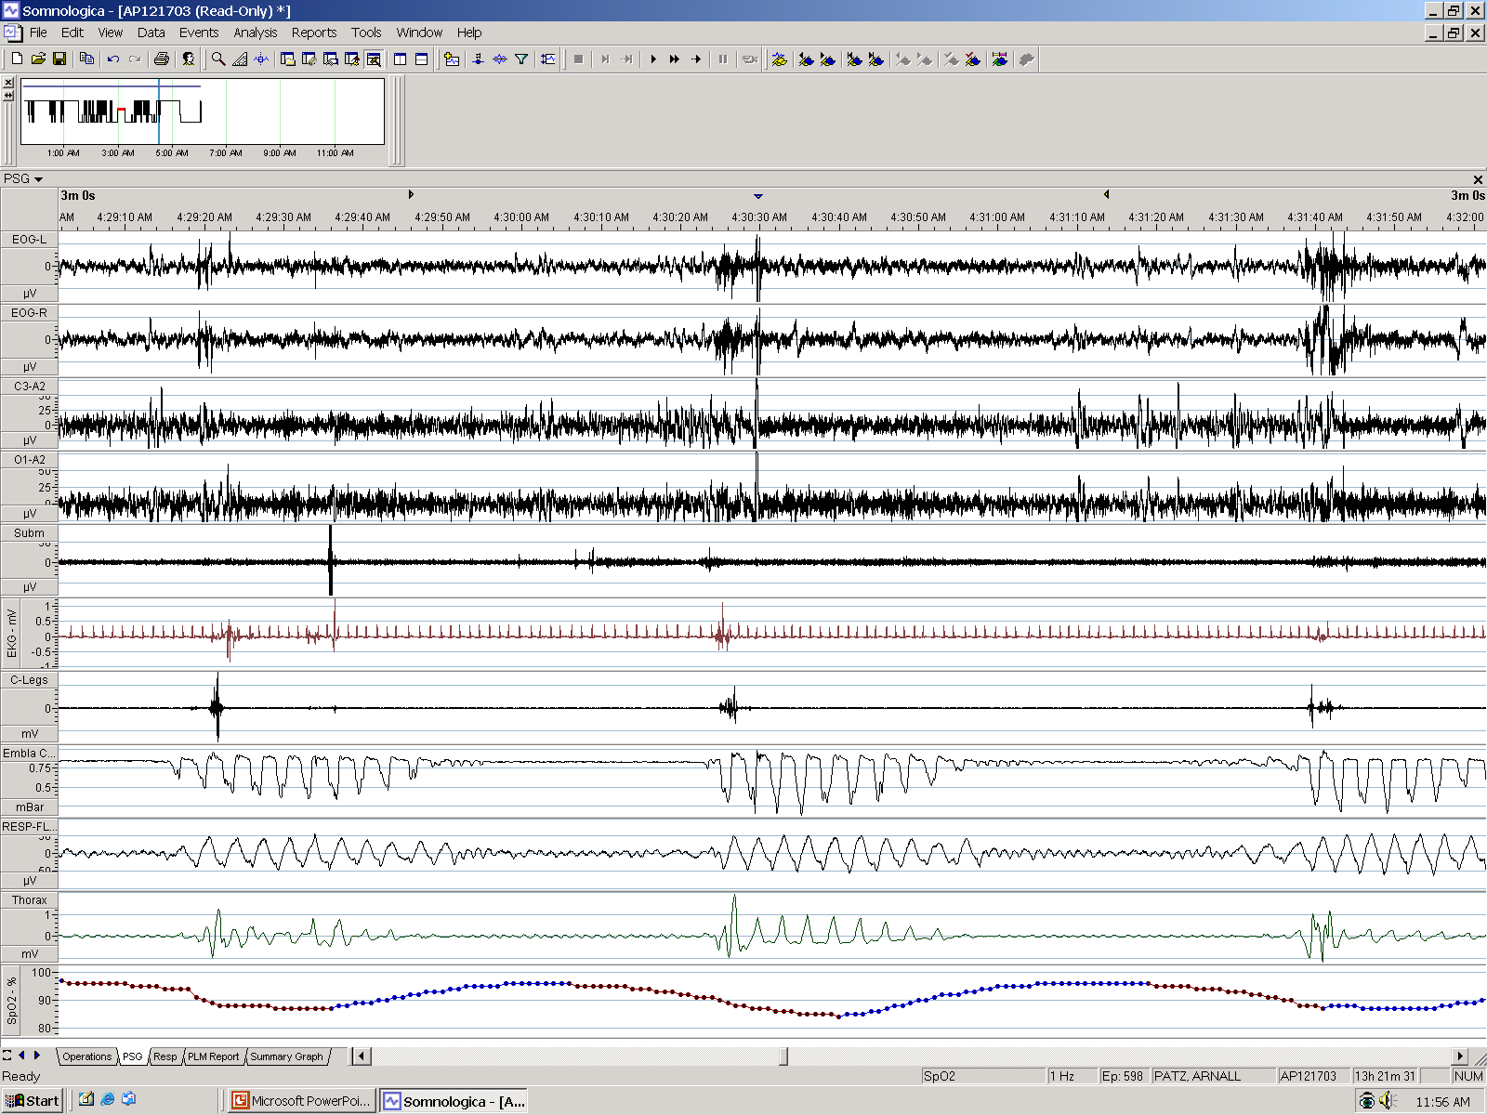
Case – Section IIII
A limited channel sleep study was available to the unit. A representative 3-minute screen of the study is presented.
HR
Snore
Airflow
Chest
Abd
SpO2

Slide 11
Questions – Section IIII
IIII. A) Are the nurse descriptions and the portable monitoring example consistent?
IIII. B) What potential causes of sleep apnea does the patient have?
IIII. C) How would you treat this patient at this time?
IIII. D) What are the management issues upon discharge from the MICU?
Notes:
IIII. A) What does the sleep study show?
Cheyne Stokes breathing – AASM definition
PSG reveals >= 5 central apneas and/or central hypopneas per hour, and central events are >50% of the total apneas and hypopneas
At least 3 consecutive central apnea/hypopneas separated by crescendo-decrescendo breathing with a cycle length of t least 40 seconds
Associated with atrial fibrillation/flutter, congestion heart failure or a neurological disorder
Symptoms of sleepiness, awakening SOB, snoring, witnessed apneas, or insomnia
Not explained by another sleep disorder, medical or neurological disorder, medication or substance use.
IIII. B) What potential causes of central sleep apnea does the patient have?
- systolic heart failure (especially with acute exacerbation, atrial fibrillation)
- enlarged left atrial size
- oxycodone use
IIII. C) How does the respiratory alkalosis contribute to the emergence of central sleep apnea in this patient?
At sleep onset, the lower PaCO2 may fall below the apnea threshold, resulting in a central apnea. The lower PaCO2 during wakefulness is often due to chemoreflex hypersensitivity, which would set a higher alveolar hyperventilation rate at baseline. Associated to chemoreflex hypersensitivity is hypercapneic ventilatory hyperresponsiveness – in which the change in ventilation in response to fluctuations in CO2 are exaggerated, thus perpetuating the periodic breathing noted in Cheyne Stokes Respiration.
IIII. D) How would you treat this patient at this time?
Initial treatment directed at conditions that ay be causing or exacerbating CSA – heart failure, opioid use.
If symptoms persist, then CSA-specific therapy
If patient has severe consequences of CSA, then CSA-specific therapy is indicated
For hyperventilation-related CSA (primary CSA, CSR, medical condition, high altitude)
CPAP
Can be in-lab titration to eliminate central apneas
Also acceptable, as in CanPAP study, over 2-3 nights in hospital, start at CPAP 5 and titrate up to max CPAP 10.
ASV
BPAP with backup rate
All patients with hypoxemia during sleep should receive supplemental oxygen

