Slide 1
Restless Leg Syndrome
Case Study
James A. Rowley, MD
for the Sleep Education for Pulmonary Fellows and Practitioners, SRN ATS Committee
May 2015

Slide 2
Part 1: Case Presentation
AF is a 35 year old female who comes to your office with complaints of difficulty falling asleep at night for the last year.

Slide 3
Questions
What are important components of a good history focused on insomnia?
What is the differential diagnosis of insomnia?

Slide 4
Case Presentation
Upon further questioning, AF states:
  Bedtime is at 11p and generally takes her 30-45 minutes to fall asleep
  Wake time is 7a weekdays, 8a on weekends
  When cannot fall asleep, generally stays in bed watching the clock
  While trying to fall asleep, feels restless and is constantly moving her legs
  Does not watch TV or read in bed
  Only drinks juices or herbal tea after dinner
  Does not smoke or consume alcohol
  Is generally sleepy when gets into bed at night
  Does not worry about her sleep during the day
  Feels fatigued during the day

Slide 5
Questions
What additional questions should be asked to confirm the diagnosis of restless leg syndrome?
Are there any questionnaires for RLS?

Slide 6
Case Presentation
Upon further questioning, AF states that:
  The restlessness in her legs often feels like something is crawling up them
  The restlessness generally improves if she moves her legs around
  She occasionally notices the creepy-crawly feeling when watching TV in her living room if lying on couch
  Symptoms bother her at least 4 nights per week
  Had similar symptoms about 5 years ago during her pregnancy
  Her father and brother have similar symptoms

Slide 7
Part II: Diagnostic Testing
Given the diagnosis of RLS:
  Which medications need to be checked for?
  What diagnostic testing is indicated?

Slide 8
Case Presentation
Upon further questioning:
  AF only medication is omeprazole for GERD
Ferritin level is 80

Slide 9
Questions
What treatment options are available for RLS and what would you recommend for this patient?
Is RLS associated with other medical conditions and long term health outcomes?

Slide 10
Part III: Treatment
You prescribe AF pramipexole 0.25 mg one hour before bedtime.
AF returns after 2 months with marked improvement in:
Symptoms of restlessness: now only bother her about 1x/month
Sleep latency most nights ~10 minutes

Slide 11
Question
What is the relationship between RLS and periodic limb movements during wakefulness (Figure 1) and sleep (Figure 2) as observed on a sleep study?

Slide 12
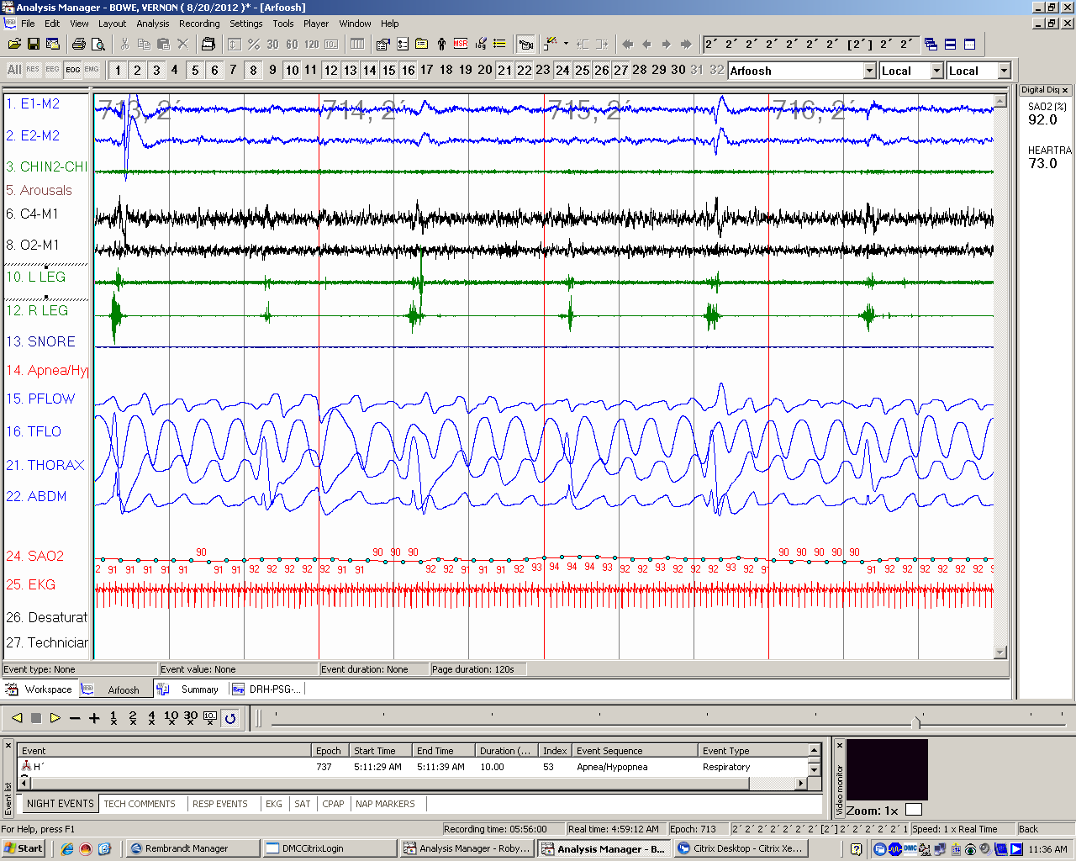
Figure 1:
Tracing of PLMs during Sleep

Slide 13
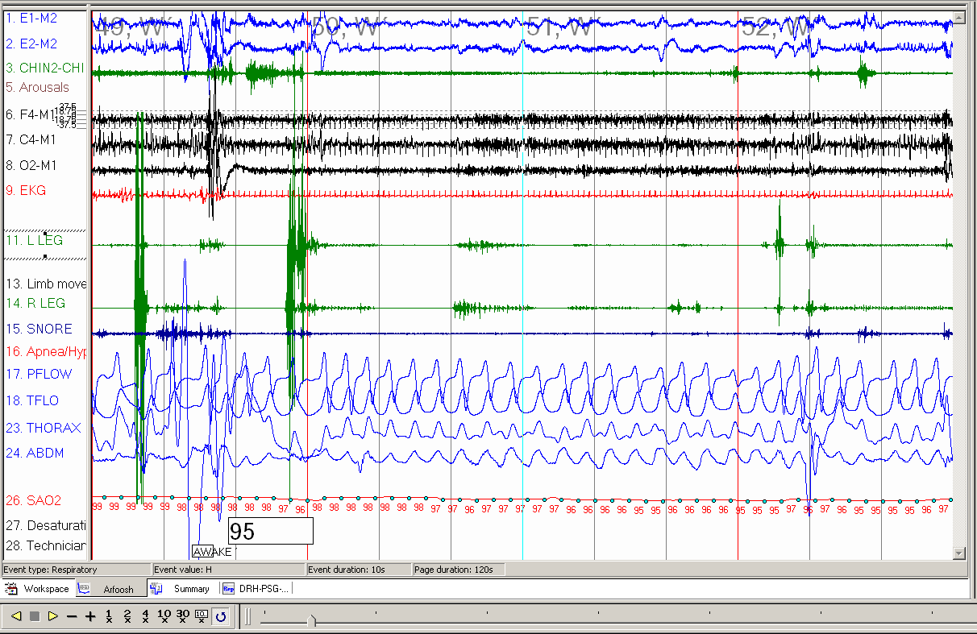
Figure 2:
Tracing of PLMs during Wakefulness

